Slide 1
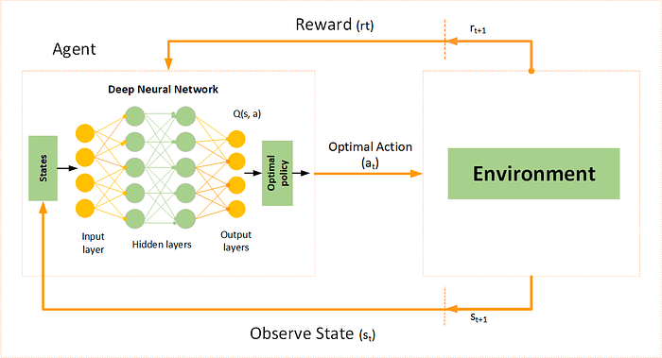
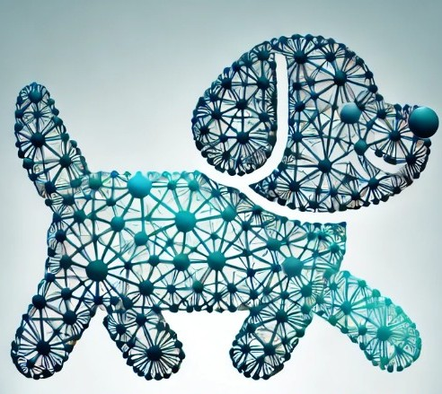
Deep Q Networks (DQN)

Slide 2
Q-Learning
In finite state, finite action, we use Q-Learning to learn the Q table
For each State we find the corresponding best action Q(s,a)
In real life we can not hold it in a table:
State space too big/infinite
Action space too big/infinite

Slide 3
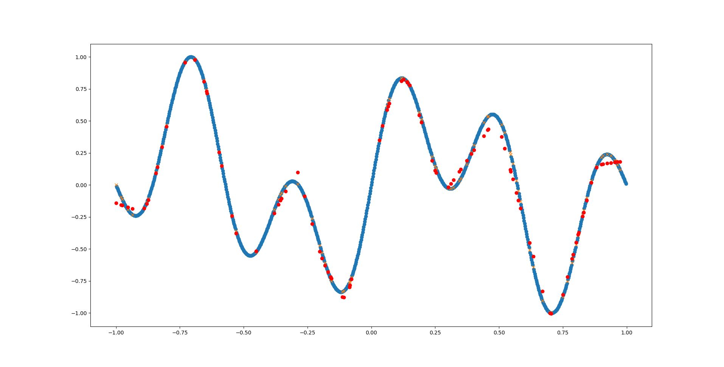
Function Approximation

Slide 4
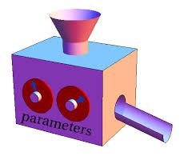
Function Machine
Function maps Input to Output
Output = f(x)
Different function machines have different internal structure.
A very useful machine is Deep Neural Network. It’s parameters are the weights on the arcs.
State
Q(s,a) values

Slide 5
What does DNN need in order to learn
Data to learn from (input + output) (e.g. image, cat/dog label)
Loss function to back-propagate the error and correct the weights

Slide 6
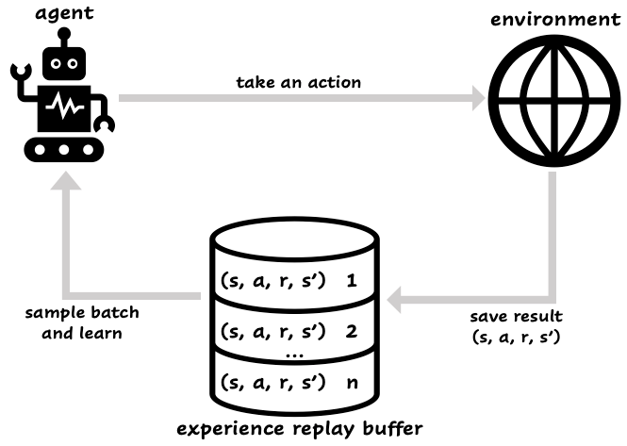
Where are we getting the data from
The agent plays episodes, for each state it stores the (S,A,R,S’) in a replay buffer
The replay buffer has a finite size
During training we randomly sample from the replay buffer

Slide 7
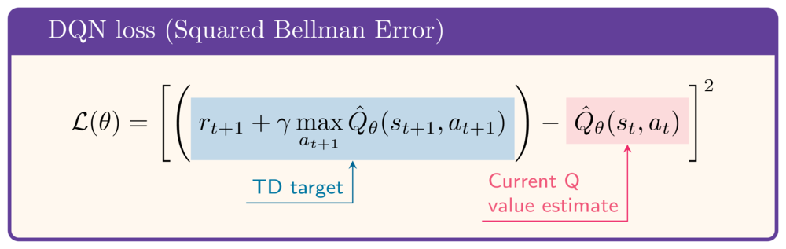
DQN Loss function

Slide 8
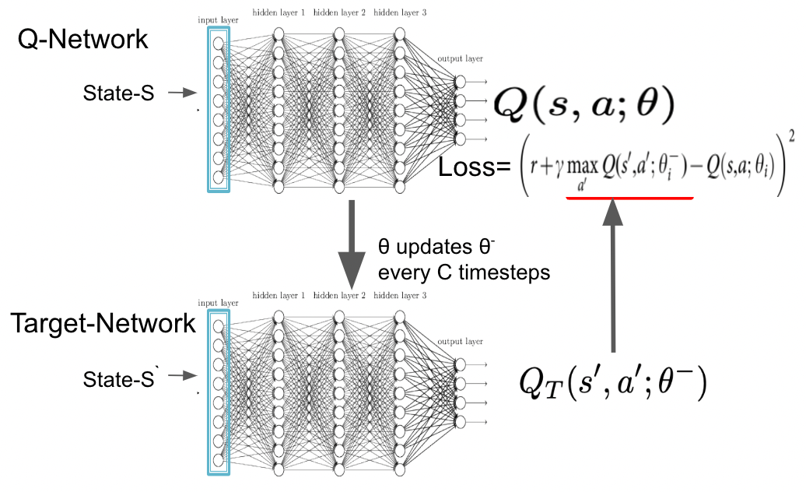

Slide 9
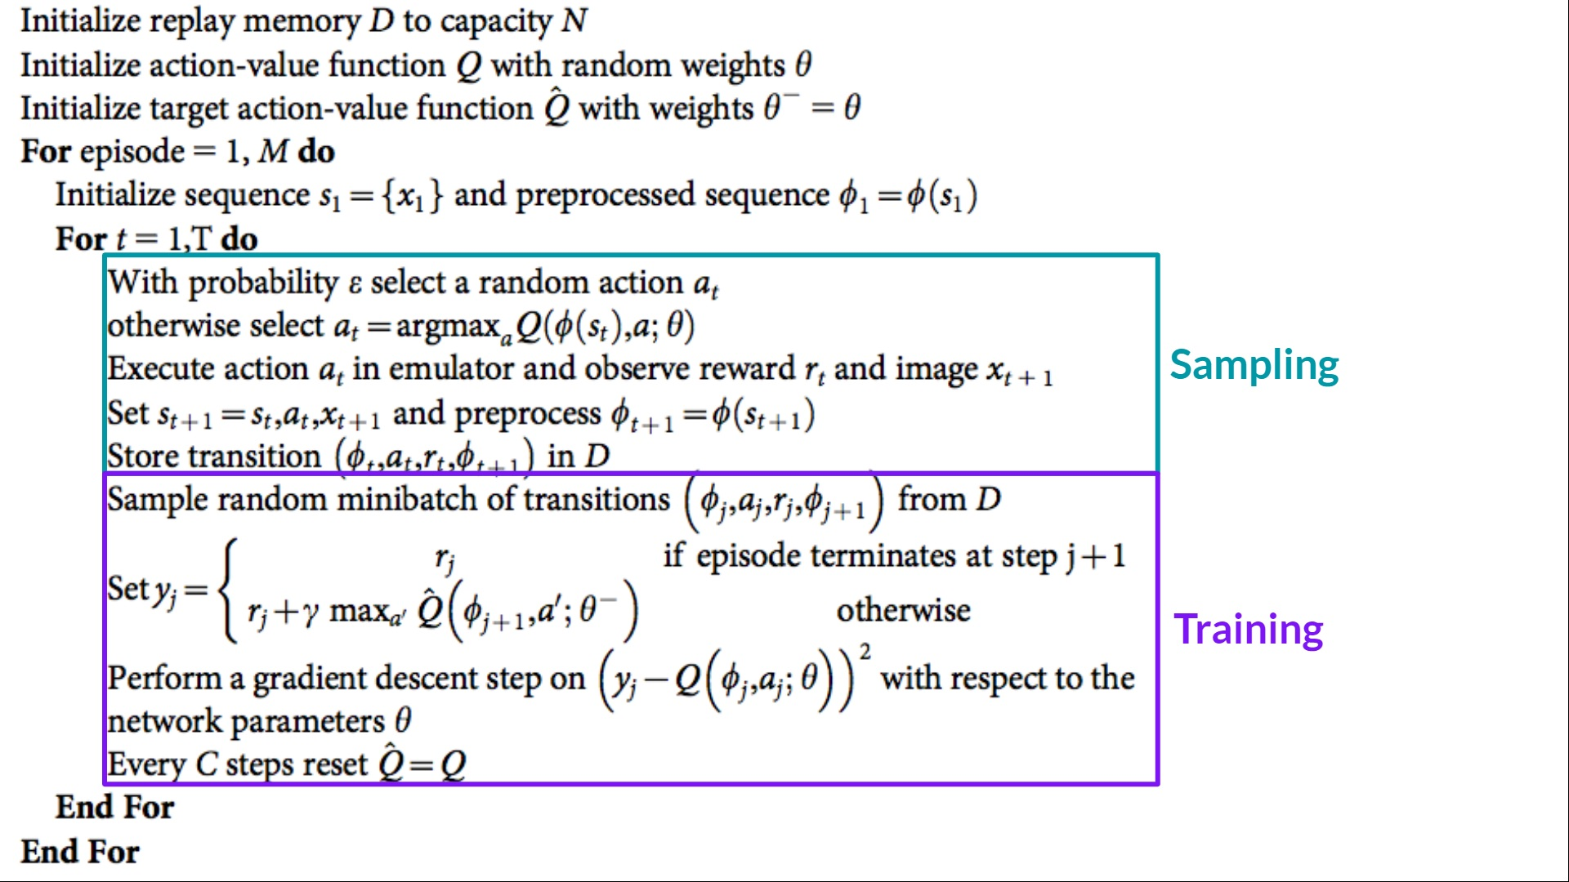
DQN Algorithm

Slide 10
The Replay Buffer
https://lazyprogrammer.me/what-is-the-replay-buffer-in-dqn-deep-q-learning/
Motivation for the Replay Buffer
Before DQN, reinforcement learning methods often suffered from instability and poor sample efficiency when using deep neural networks as function approximators. The primary reasons for these challenges were:
Sequential Correlation in Online Learning: In traditional online learning, experiences are highly correlated since they are generated consecutively by the agent. Training a neural network on these sequential samples can lead to inefficient learning and divergence.
Non-IID Data: Neural networks perform best when trained on independent and identically distributed (IID) data. However, in reinforcement learning, observations depend on previous actions and states, making the data highly non-IID.
Inefficient Data Usage: Without reusing past experiences, each experience is used only once, leading to inefficient learning and requiring more interactions with the environment.
To address these issues, the replay buffer was introduced as a mechanism to break the correlation in training data and improve learning efficiency.

Slide 11
How does the Replay Buffer works
The replay buffer is a finite-sized memory that stores past experiences, typically in the form of tuples:
t = (s, a, r, s’, d)
where:
s: Current state
a: Action taken
r: Reward received
s’: Next state
d: Done flag (indicating if the episode has terminated)
The basic workflow of the replay buffer is as follows:
Experience Collection: As the agent interacts with the environment, experiences (s, a, r, s’, d) are stored in the replay buffer.
Sampling for Training: Instead of using the most recent experience for updating the Q-network, a mini-batch of experiences is sampled randomly from the buffer.
Gradient Descent Update: The neural network is trained using the sampled batch, computing the Q-value targets and minimizing the loss function.
Buffer Management: If the buffer reaches its maximum capacity, the oldest experiences are removed to make room for new ones.

Slide 12
Benefits of the Replay Buffer
a) Breaks Temporal Correlations
By storing past experiences and sampling randomly, the replay buffer ensures that updates are less correlated, helping the neural network generalize better.
b) Increases Sample Efficiency
Instead of discarding each experience after one update, the replay buffer allows experiences to be reused multiple times, reducing the number of interactions needed with the environment.
c) Reduces Variance and Stabilizes Learning
Using a mini-batch from past experiences leads to more stable gradient updates, reducing the variance in learning and preventing drastic fluctuations in policy updates.
d) Enables Off-Policy Learning
Since the agent learns from stored past experiences, the learning process is off-policy, meaning it can learn from experiences generated by different policies. This allows for greater flexibility in training.

Slide 13
Challenges and Limitations
Memory Usage: Large replay buffers require significant memory, especially in high-dimensional environments like image-based RL tasks.
Staleness of Data: Older experiences may become less relevant if the environment dynamics or policy changes significantly.
Sampling Strategy: While uniform sampling is simple, it may not be optimal. More sophisticated sampling strategies (like PER) can introduce additional hyperparameters and computational complexity.

Slide 14
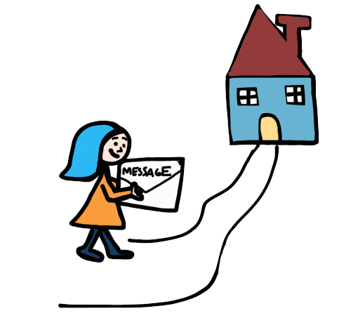
Take home message
Creating a Q-Table is not feasible in many cases, in these cases we will use function approximation
DNN are powerful function approximation
The method
We use MC methods to sample the state action space and store it in replay buffer (S,A,R,S’)
We train the network using 2 networks, policy network and target network.
We use the TD difference for the loss function
We sample the replay buffer to supply training data.

